Slide 1



An Introduction to
Machine Learning in
POWER BI

Slide 2









Sponsors
Thank you!
We couldn’t do it without you.

Slide 3
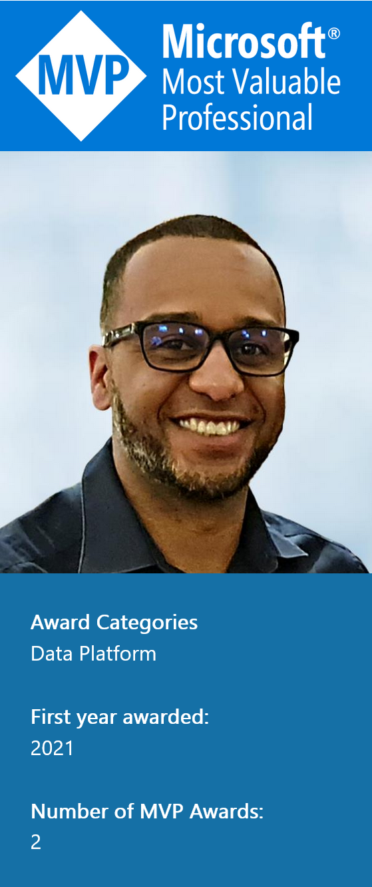
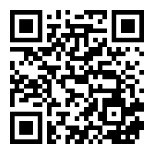


Leon Gordon
LinkedIn - https://www.linkedin.com/in/leon-gordon/
Web – pomerolpartners.com
Microsoft Power BI UK User Group - https://www.linkedin.com/groups/8909321/
DataDNA Dataset Visualization Group –
https://www.linkedin.com/groups/9075495/

Slide 4

WHAT WILL WE COVER TODAY?
What is Machine Learning (ML)?
How can we benefit from ML in Power BI?
How to create a ML Model in Power BI Premium or Premium Per User (PPU)
How to create a ML Model in Power BI for free
Resources to continue learning

Slide 5


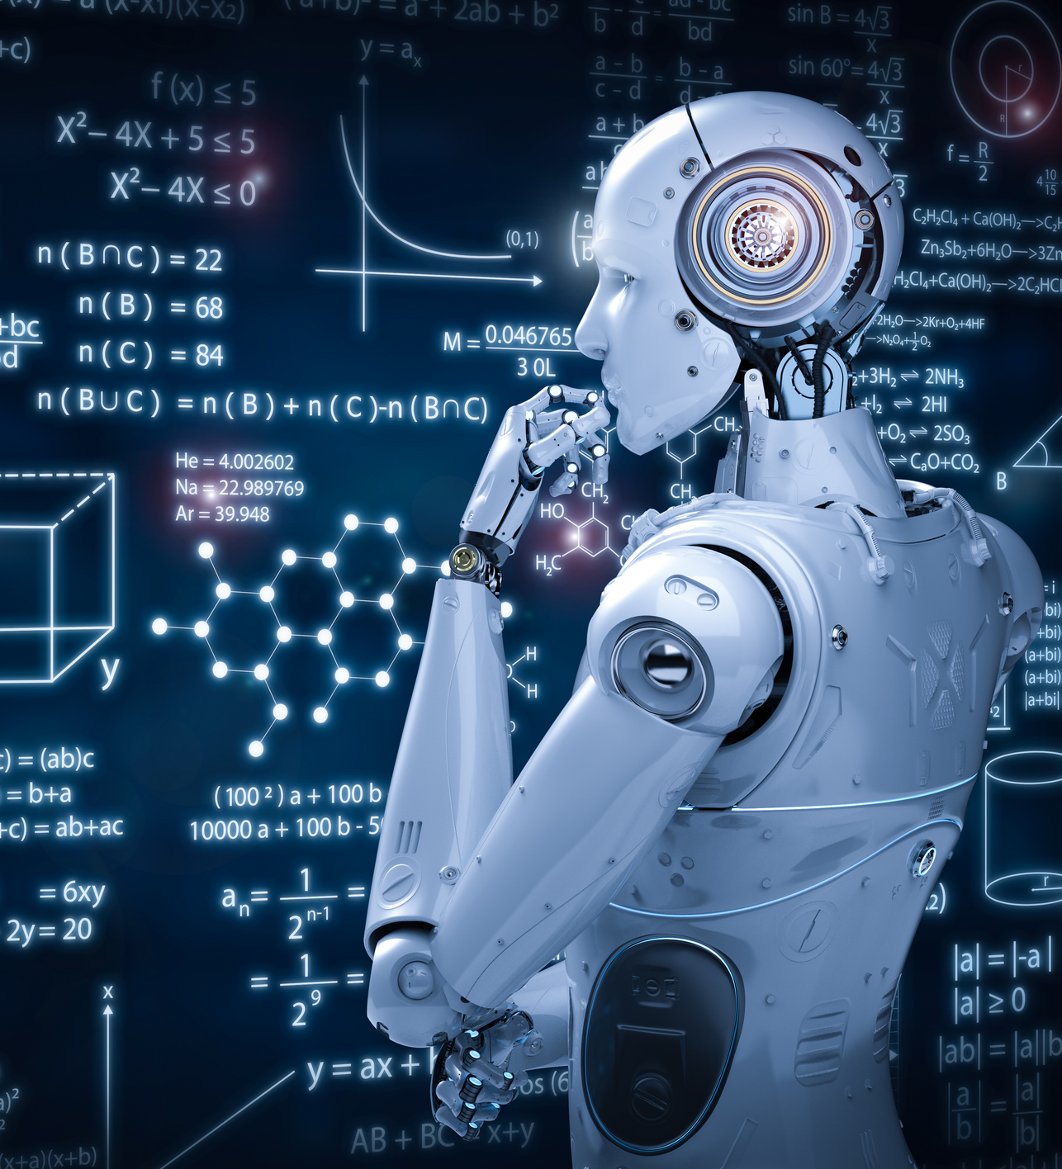
WHAT IS
MACHINE LEARNING?
—Machine learning is a branch of Artificial Intelligence (AI)
that teaches computers to do what comes naturally to
humans and animals: learn from experience.
Machine learning algorithms use computational methods
to “learn” information directly from data without
relying on a predetermined equation as a model.

Slide 6


A Brief History Of Machine Learning
Machine learning dates back to the 1940s
Arthur Samuel, a computer scientist at IBM and a pioneer in AI and computer gaming,
coined the term “Machine Learning” in 1952
Arthur designed a computer program for playing checkers. The more the program played
the game, the more it learned from its experience, thanks to a minimax algorithm
It didn’t take off until the late 1990s when IBM developed its Deep Blue supercomputer
Deep Blue beat world chess champion Garry Kasparov in 1997

Slide 7

Evolution Of Machine Learning
1949 – Donald Hebb published “The Organization of Behaviour” book
1950 – Alan Turing invented the Turing Test.
1952 – Arthur Samuel developed a computer game of checkers.
1979 – Stanford students built the Stanford Cart, a remotely-controlled autonomous cart.
1997 – IBM’s supercomputer beat Garry Kasparov in chess.
2012 – Google developed Google Brain, an ML algorithm for recognizing cats in images and videos.
2014 – Facebook created DeepFace, a facial recognition system capable of detecting faces in images, and accurately identifying humans.
2016 – Google’s AI-powered AlphaGo beat a professional player in Go, an abstract strategy board game.

Slide 8



How can we benefit from
MACHINE LEARNING
in Power BI?

Slide 9
REAL-TIME PREDICTIONS
CHURN ANALYSIS
CUSTOMER LEADS AND CONVERSION
PREDICT FRAUD

Slide 10
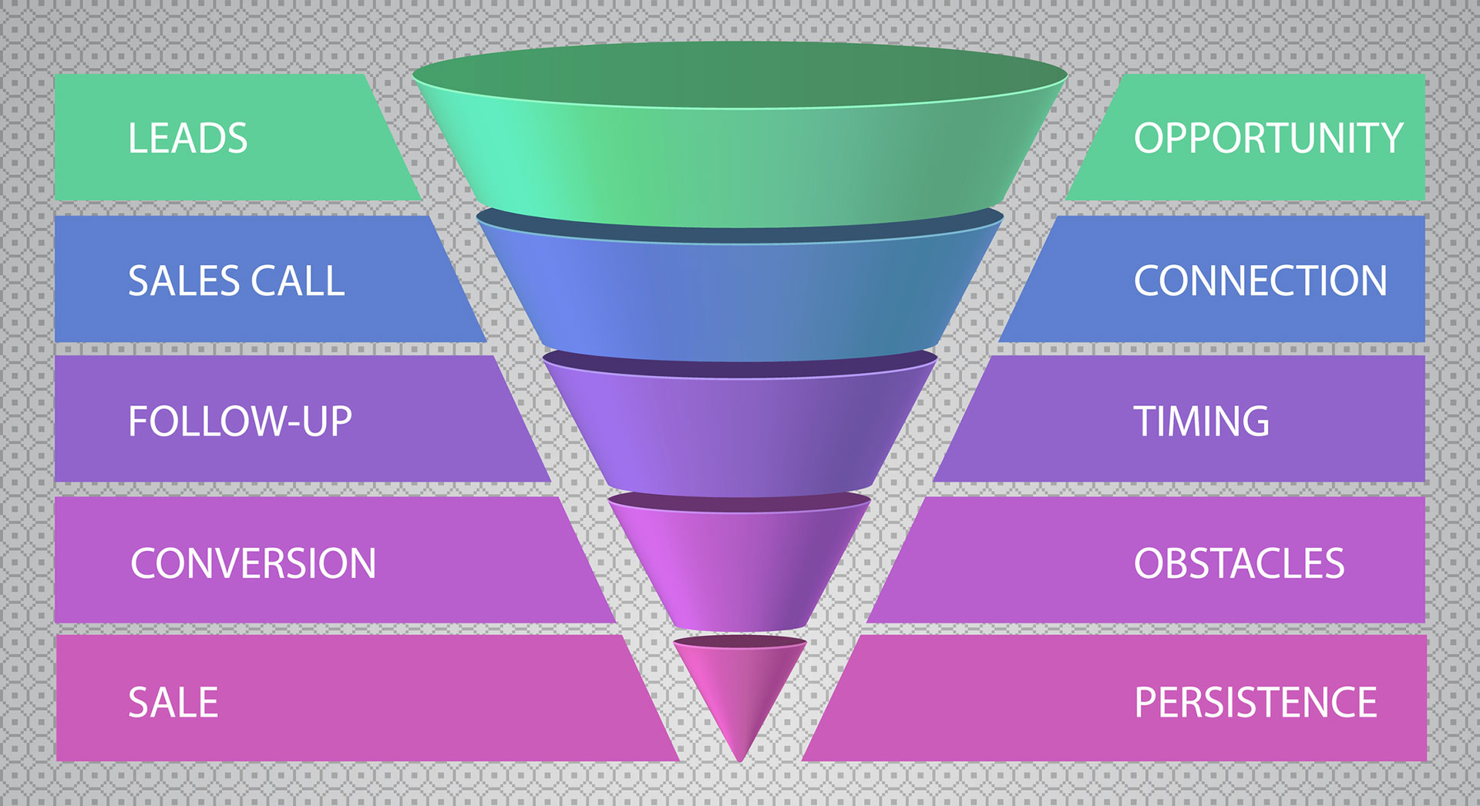

The Problem:
£3m lead spend
4.3% conversion rate

Slide 11

How can we use
MACHINE LEARNING
in Power BI?

Slide 12
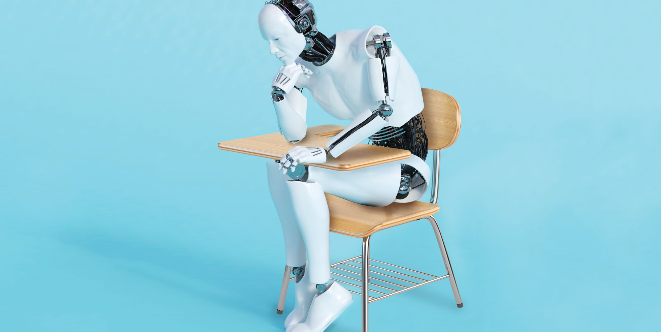

LET'S MAKE THE
MACHINE LEARN
— *No machines were harmed
in the making of this demo

Slide 13
LIMITATIONS TO THIS APPROACH
No Machine Learning Ops (MLOps)
Only personal gateway available
Difficult to manage dependencies
Not scaleable

Slide 14


ALTERNATIVE TOOLS
ANACONDA
With over 25 million users worldwide, the open-source Individual Edition (Distribution) is the easiest way to perform Python/R data science and machine learning on a single machine. Developed for solo practitioners, it is the toolkit that equips you to work with thousands of open-source packages and libraries.
https://www.anaconda.com/products/individual
—What additional tools can we use for machine learning in Power BI?
PYCARET
PyCaret is an open source, low-code machine learning library in Python that allows you to go from preparing your data to deploying your model within minutes in your choice of notebook environment.
https://pycaret.readthedocs.io/en/latest/installation.html

Slide 15

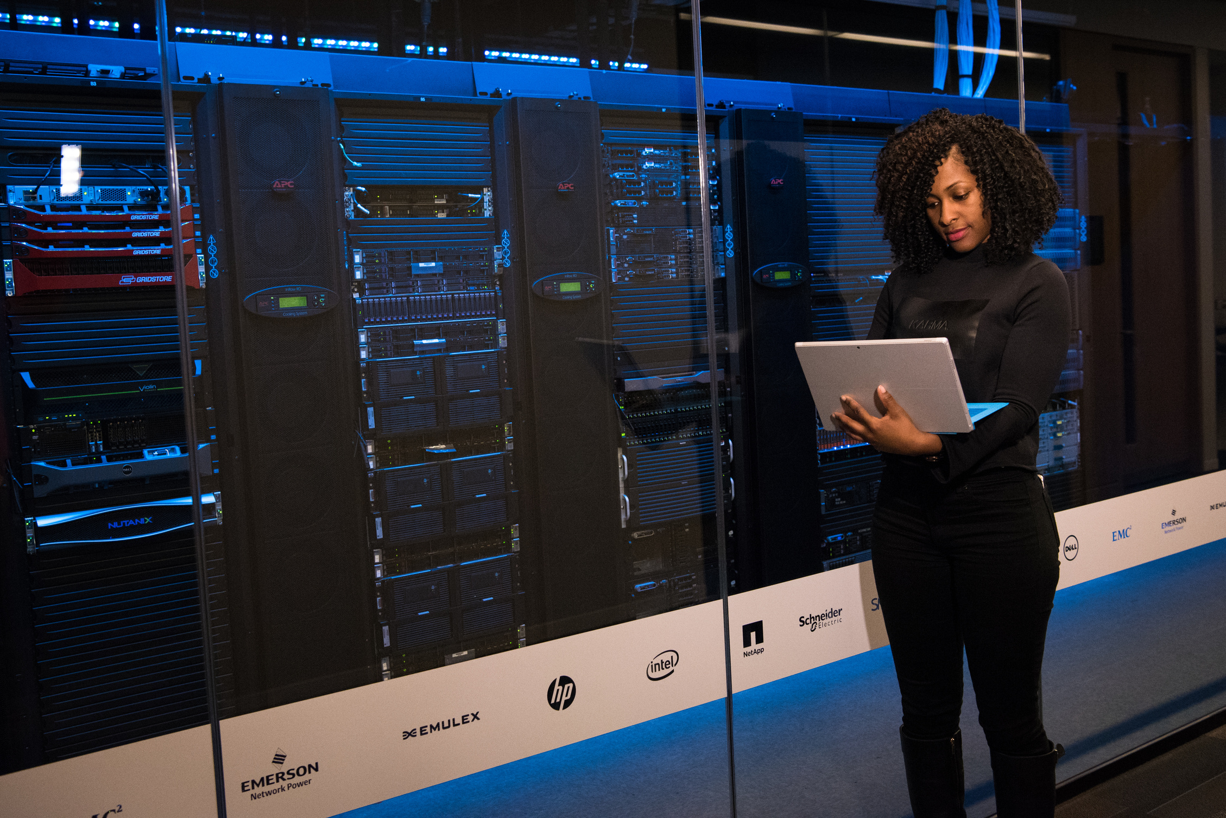

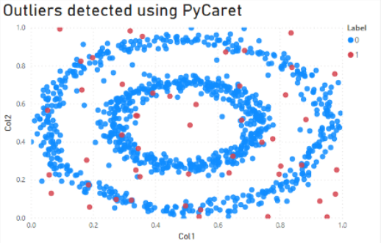
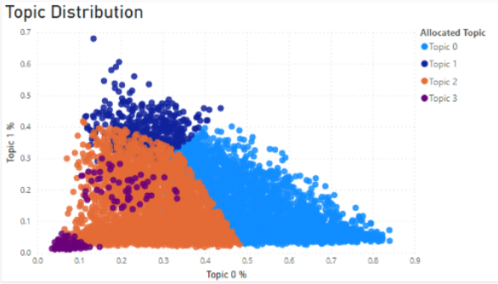
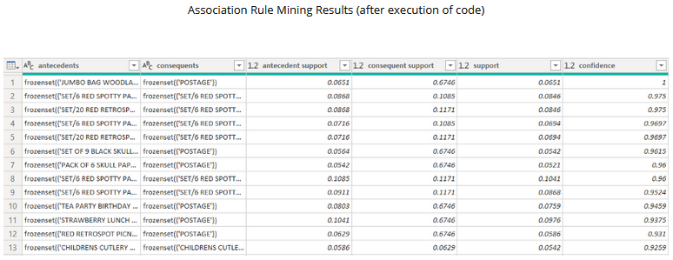
WE NOW HAVE A VISION..
—Here's how we can take it to a new level
Credit: KDNuggets

Slide 16

MORE RESOURCES
https://www.amazon.co.uk/Extending-Power-Python-transform-analytical-ebook/dp/B09CQ5G53Y/
https://www.kdnuggets.com/2020/05/machine-learning-power-bi-pycaret.html
https://towardsdatascience.com/build-your-own-automl-in-power-bi-using-pycaret-8291b64181d
https://www.anaconda.com/
https://docs.microsoft.com/en-us/power-bi/connect-data/service-tutorial-build-machine-learning-model

Slide 17


QUESTIONS?

Slide 18
Leon Gordon
LinkedIn - https://www.linkedin.com/in/leon-gordon/
Web – pomerolpartners.com
Microsoft Power BI UK User Group - https://www.linkedin.com/groups/8909321/
DataDNA Dataset Visualization Group –
https://www.linkedin.com/groups/9075495/

